Slide 1
Machine Learning for Cybersecurity
Module 2: Applications to Networking
University of Chicago
Fall 2020

Slide 2

Who Am I?
Professor Nick Feamster
Networking, Machine Learning, and Security
Applications of Machine Learning (anomaly detection, classification)
Applications to Public Policy (broadband deployment, digital divide, …)

Slide 3
Applications of Machine Learning to Cybersecurity

Slide 4
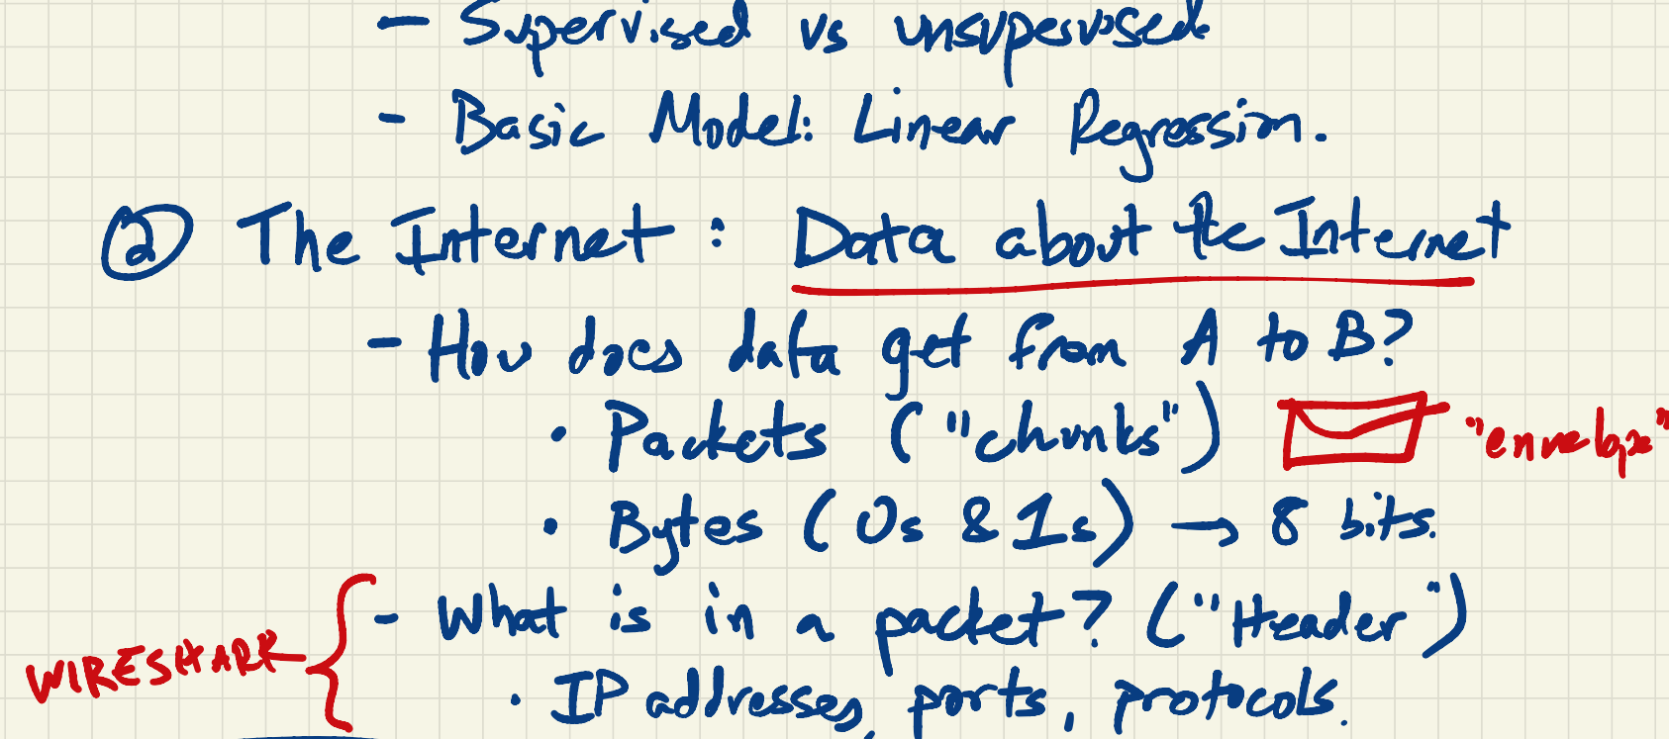

Slide 5
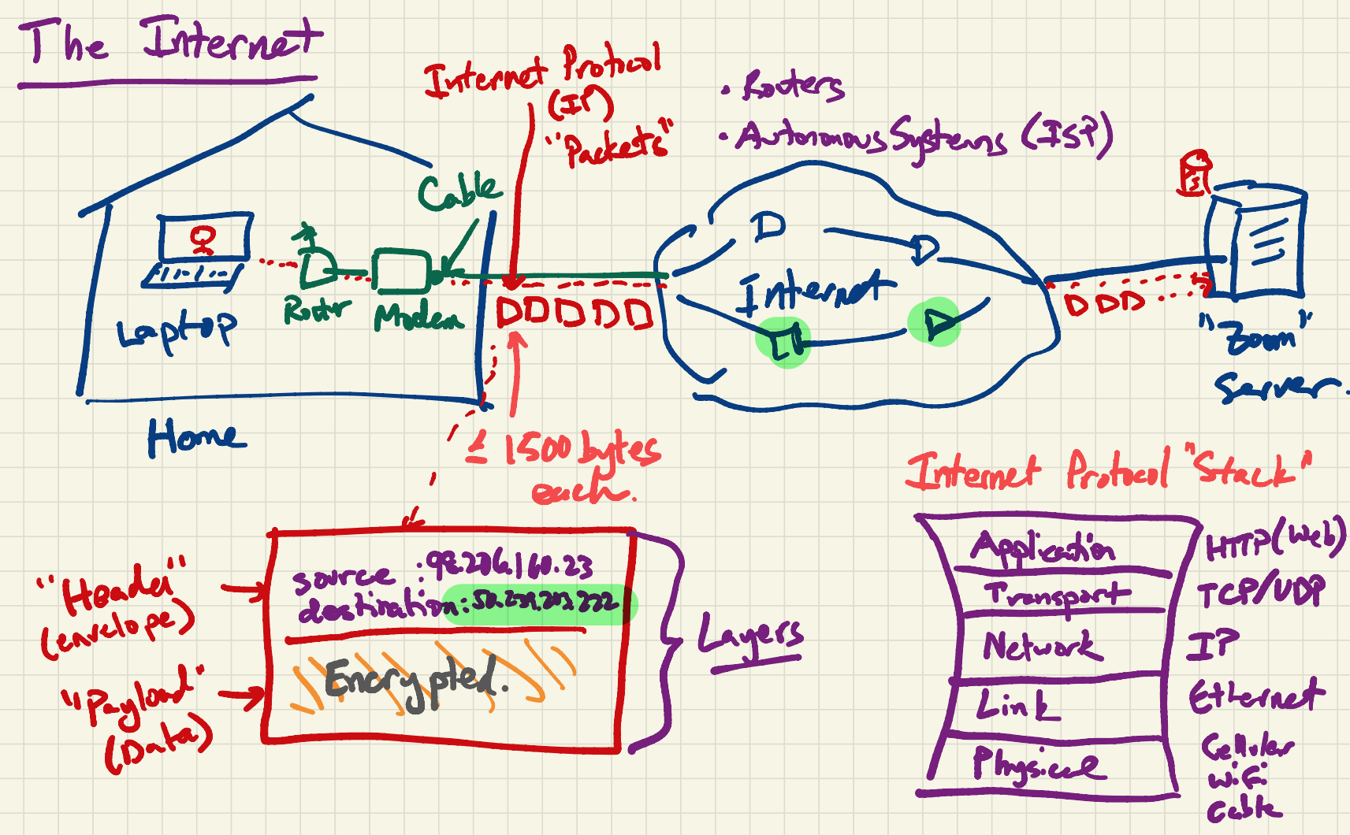

Slide 7
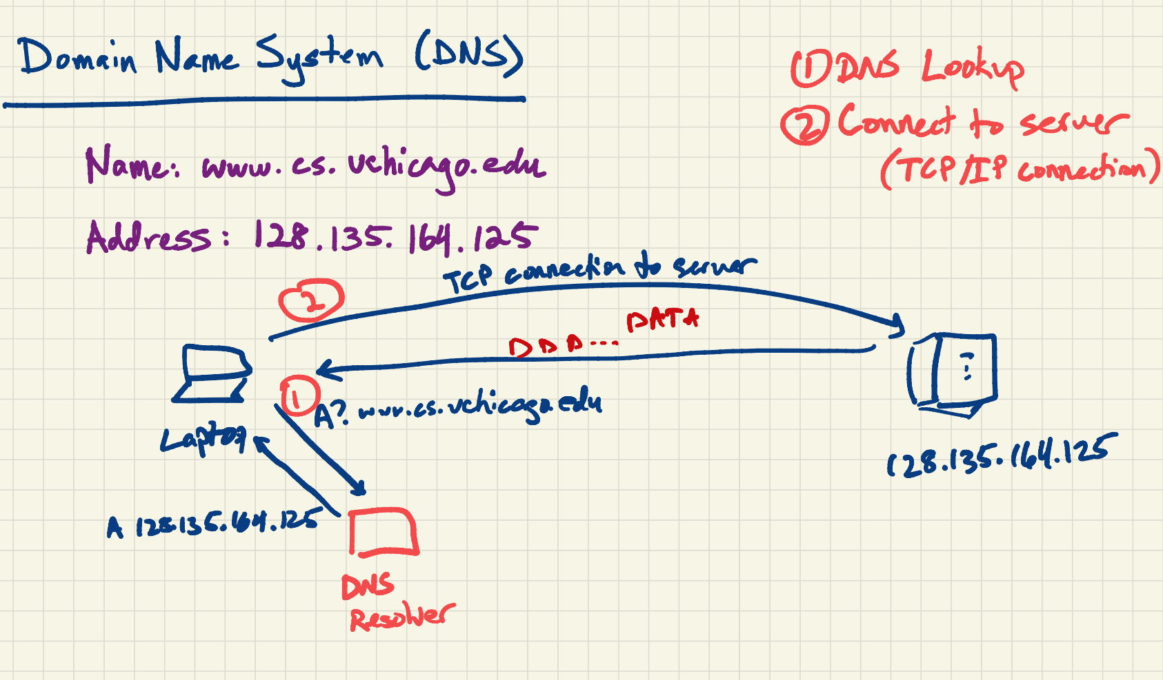

Slide 8
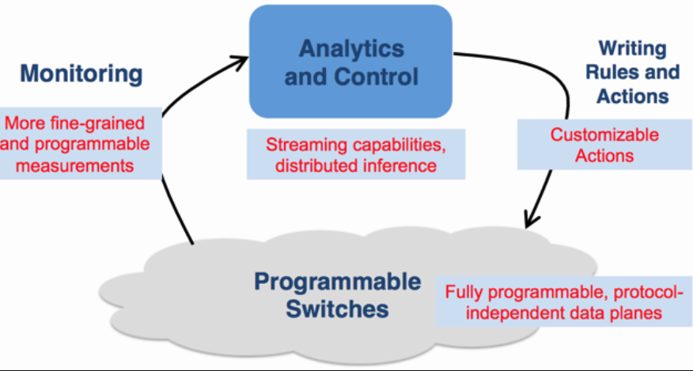

Slide 9
Modeling: Data Representation
We aim for general representations, with consideration of cost/complexity as part of the optimization.
Many challenges for representing the data
Scale (constantly generated)
Sequential dependencies (handshakes, parameter negotiation)
Non-uniform timeseries (network traffic is “bursty”)
Cross-flow dependencies (applications don’t use one flow)
Many choices for representing traffic data, with different costs.
Packet: Each packet is raw input to the model.
Event: Each “traffic event” is a data point (e.g., spike in traffic). (Could also sub-select on only anomalous events, such as deviation from moving average.)
Time: Traffic statistics are grouped/binned in time (challenge: bin size)
Volume: Bins based on volume (non-uniform intervals). (Standardizes events.)

Slide 10
Modeling: Model Selection
Consider problems with different levels of complexity.
Simple Detectors: Non-Temporal Models
Random forest, SVM
Convolutional Neural Network
Work on some representations (volume based)
Challenge: Do not capture temporal features
More Complex Detectors: Temporal Models
Long Short-Term Memory (LSTM), Gated Recurrent Units (GRU)
Can be used to capture temporal information from the features

Slide 11



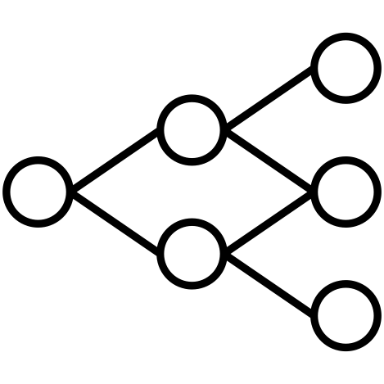
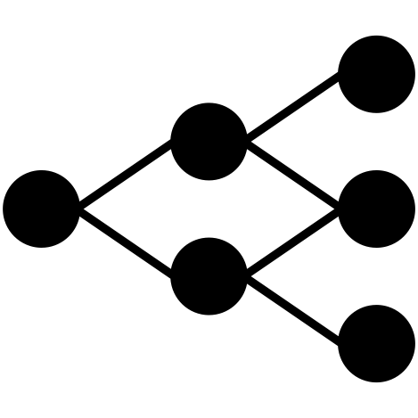
General Traffic Analysis Framework
Labels
Representation
Compression
(Optional)
Input
(Packets)
Packet
Transformation
Data
Representation
Model
Training
Output
(Trained Model)
Each step has an associated cost.
Goals:
Explore general capabilities, capturing the limits of what is possible in traffic analysis
Consider cost-accuracy tradeoffs
Notes:
Our pipeline works, but what if we want to make the representation even smaller?
Faster training
Faster transformation

Slide 12
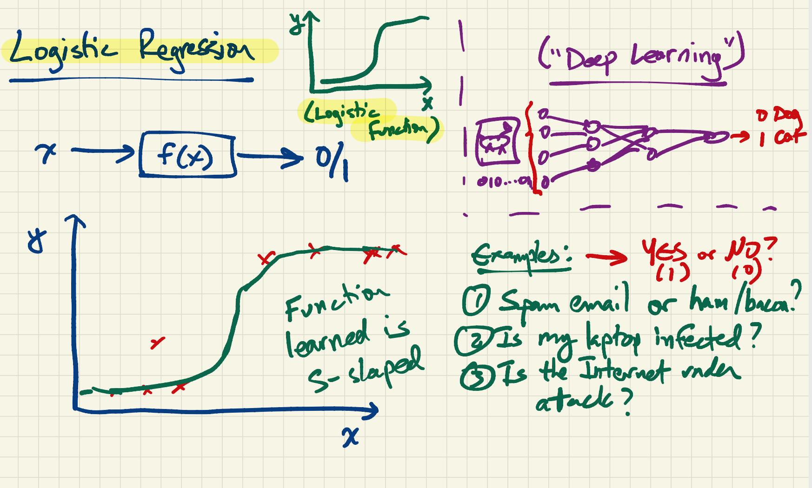

Slide 13
Applications of Machine Learning to Cybersecurity

Slide 14
Forensics: Challenges and Opportunities
Problem
More data is better
Need to decide what to capture ahead of time
Identify features (events, network traffic features, etc.) that could trigger more detailed logging
Needs
Detection of rare events
Triggers are rare, but must detect with high accuracy

Slide 15
Application-Layer DoS
Conventional attacks: Volumetric
Send high volumes of traffic towards victim
Modern attacks: Application-layer, low-volume
Exploit network traffic that can consume an aysmmetric amount of resources
SSL handshakes, DNS traffic (“amplification attacks”), Database operations
Challenge: Simply counting traffic volumes will not suffice.

Slide 16
Application-Layer DoS Detection
Goal: Identify network-level traffic characteristics that are suggestive of application-layer DoS.
Opportunities for machine learning
Graph analysis: Detection of abnormal request patterns (domains, clients) at an open resolver
Time-series analysis: Detection of level shifts in DNS queries

Slide 17
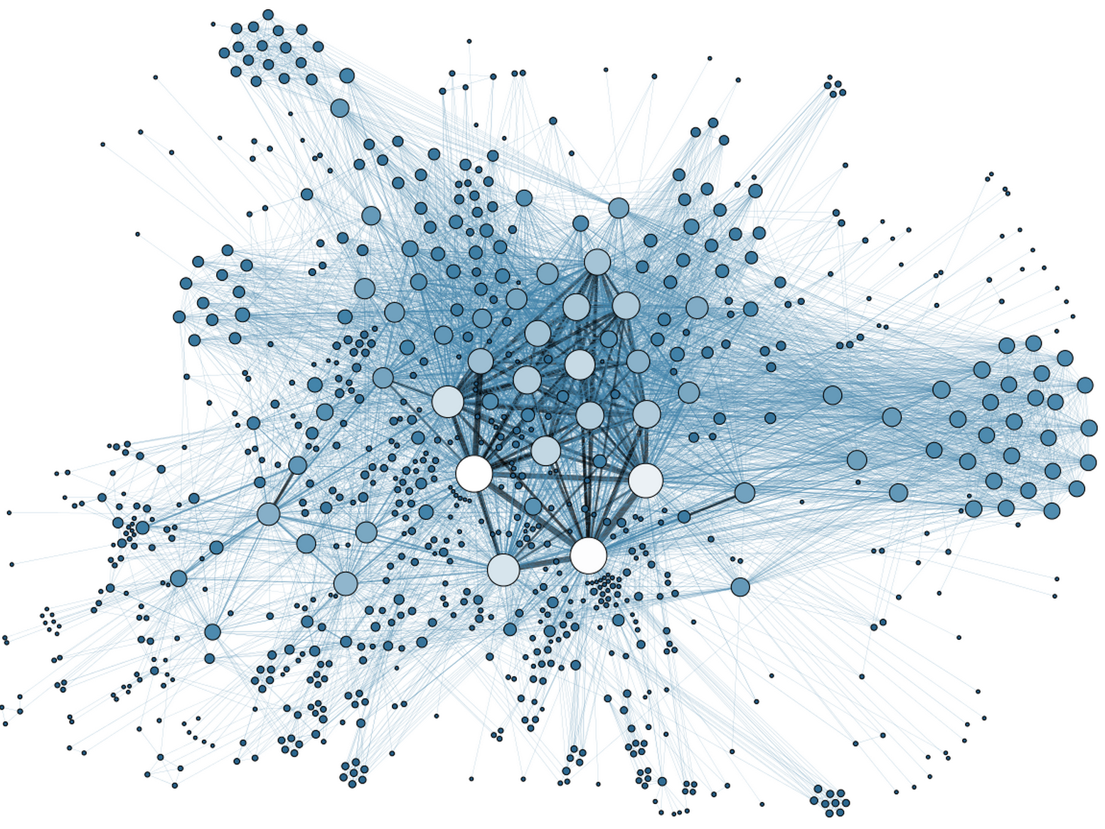
Exfiltration and Insider Threats
Problem
Determine when an employee is a “flight risk” or otherwise a risk for leaking data
Insight: Sometimes flight risk is preceded by changes in communication patterns
Goal: Use data about communication patterns to detect probability of flight risk
Increase defenses (e.g., firewalling) if exfiltration could be predicted
Currently: No good solutions

Slide 18
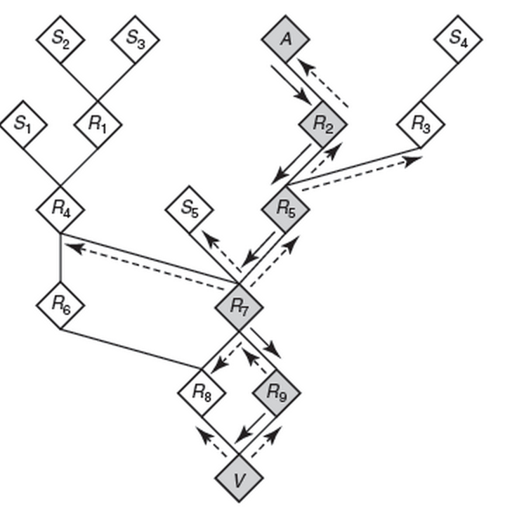
Forensics
Post-intrusion, trace back the source of attack
What happened?
Where did attack come from?
Was any data lost?
Requires extensive logging (prohibitive)
Need to determine when and where to activate intensive logging.
Currently: Difficult

Slide 19
Exfiltration and Insider Threats
Opportunities for machine learning
Analyzing communication patterns using graph analysis
Detection of rare events
Requires incorporation of many heterogeneous datasets (e.g., communication logs, traffic patterns, etc.)

Slide 20
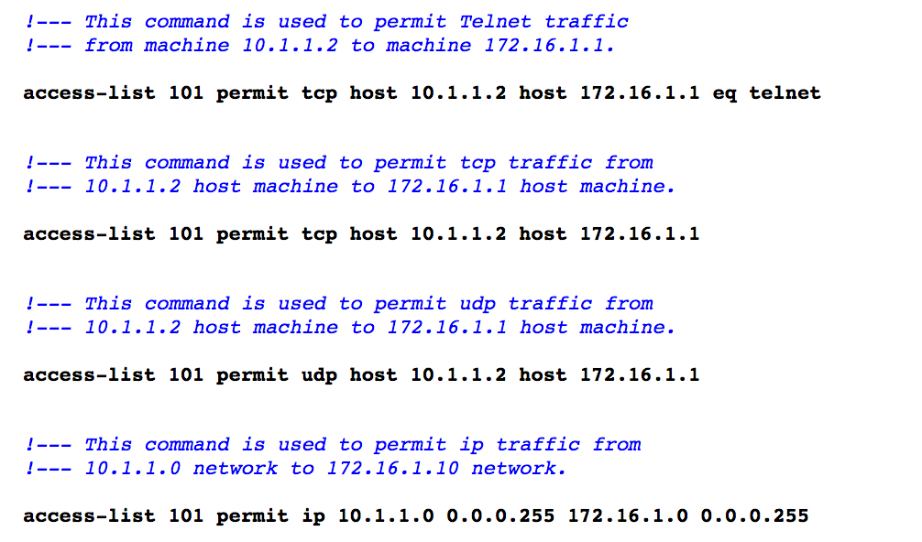
Automating Access Control Lists
Problem
Access control lists need to be continually updated
They can also get overly long if old rules are not removed, consolidated, etc.
Currently: Manual
Need better ways to automate, verify, and optimize

Slide 21
Automating Access Control Lists
Goal: Automate ACL provisioning, removal, optimization
Machine Learning Capabilities
Clustering techniques can identify common idioms
Traffic analysis can help identify “dead code”
Time-dependent dataset analysis can predict which ACLs are needed, and when
Future: Coupling with SDN for “closed loop” automation

Slide 22
Summary
Many network tasks rely on data analysis, domain knowledge, and predictive analytics
Two main problem areas: Detection and Prediction
Various network management problems
Configuring the network in the first place
Detecting and reacting to faults
Detecting and mitigating attacks
Predicting the effects of configuration change

Slide 23
Security: From Reactive Defense to Predictive Analytics

Slide 24
Many Cybersecurity Problems Involve Large-Scale Predictive Analytics
Rare events
Time-series analysis
Analysis of heterogenous data
Analysis of communication graphs
Need to analyze data in real time
Need to detect outliers

Slide 25
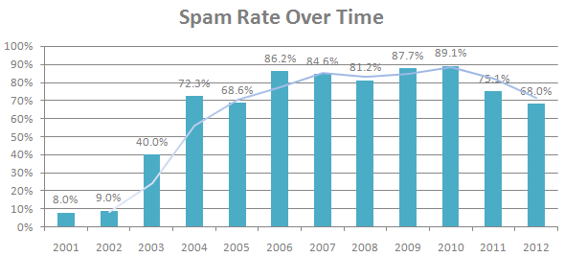
Unwanted Traffic: Spam
70-90% of all email traffic is spam
(Sources: Symantec 2010, MAAWG 2011, Symantec 2013)

Slide 26

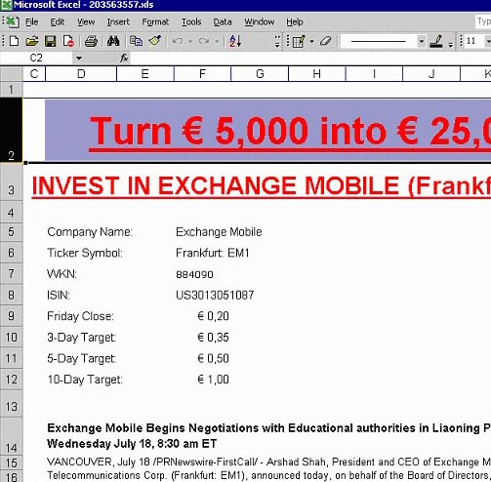

Conventional Approach #1: Content Filters
PDFs
Excel sheets
Images
...even mp3s!

Slide 27
Conventional Approach #2: IP Addresses
Received: from mail-ew0-f217.google.com (mail-ew0-f217.google.com [209.85.219.217])
by mail.gtnoise.net (Postfix) with ESMTP id 2A6EBC94A1
for <feamster@gtnoise.net>; Fri, 21 Oct 2011 10:08:24 -0400 (EDT)
Problem: IP addresses are ephemeral
Every day, 10% of senders are from previously unseen IP addresses
Possible causes
Dynamic addressing
New infections

Slide 28








A Lot Happens Before Spam is Sent!
Time
Distribute spam messages
Maintain hosting infrastructure
Acquire network resources
DNS server
Register .com domains
Botnet
Web server
Registrar
Registry
ICANN
Spam message
Spam-advertised page

Slide 29
Predictive Analytics: Detection Based on Network-Level Behavior
Filter email based on how it is sent, (in addition to simply what is sent and who sent it).
First Step: Define Behaviors (In other words, What’s different about spammers?)
Agility. Spammers need to move to escape detection.
Exposure. Spammer sending behavior differs from normal user behavior.
Coordination. Spammers behave like each other.

Slide 30
Predicting Anomalous Behavior
Agility: Spammers must escape detection
Understanding network-level behavior
Challenge: Detecting agility (BGP, DNS)
Exposure: Spammers behave differently
Supervised learning based on features
Challenge: Which features to use?
Coordination: Spammers behave like each other
Clustering based on common behavior
Challenge: What behaviors cluster well?

Slide 31
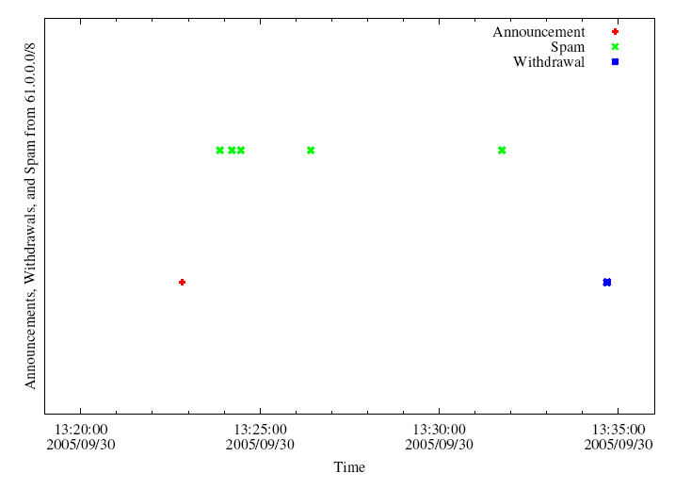
Analysis of Internet Routing Data
Hijack IP address space using BGP
Send spam
Withdraw IP address
A small club of persistent players appears to be using this technique.
Surprise: Common short-lived prefixes are huge!
61.0.0.0/8 4678
66.0.0.0/8 21562
82.0.0.0/8 8717
~ 10 minutes
Somewhere between 1-10% of all spam (some clearly intentional, others “flapping”)
Anirudh Ramachandran and Nick Feamster, “Understanding the Network-Level Behavior of Spammers”, ACM SIGCOMM, September 2006.

Slide 32
Analysis of Sending Patterns
Intuition: Spammers will “cluster” together in IP address space, because many compromised hosts may exist on a single network.
For spammers, k nearest senders are much closer in IP space
Notes:
XXX Fix This XXX

Slide 33
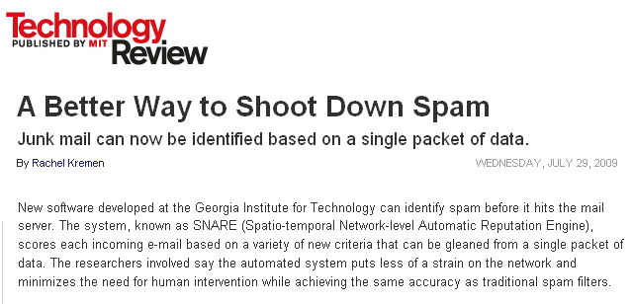

Combining Features: RuleFit
Put features into the RuleFit classifier
10-fold cross validation on one day of query logs from a large spam filtering appliance provider
Using only network-level features
Anirudh Ramachandran, Nick Feamster, and Santosh Vempala, “Filtering Spam with Behavioral Blacklisting”, ACM CCS, 2007
Shuang Hao, Nick Feamster, Alex Gray and Sven Krasser, “SNARE: Spatio-temporal Network-level Automatic Reputation Engine”, USENIX Security, August 2009

Slide 34
Going Back Earlier in Time: Attackers Use the Domain Name System
Attackers use URLs to propagate scams and malware
Idea: Use properties of the registered domains to identify spam, scams, etc.
Problem: How to identify the reputation of a domain?
Previous work relies on observing record changes, which may take time to observe.
Alternative: Look for query patterns within short time of registration.

Slide 35
Predictive Analytics and DNS
Domain registration and resource record establishment occur before attacks take place
DNS infrastructure for scam domains is located in different address space regions and autonomous systems than the infrastructure for legitimate domains.
Early lookup patterns for a newly registered malicious domain differ significantly from the patterns for a legitimate domain
S. Hao, N. Feamster, R. Pandrangi. “Monitoring the Initial DNS Behavior of Malicious Domains”, ACM SIGCOMM Internet Measurement Conference, November 2011.

Slide 36
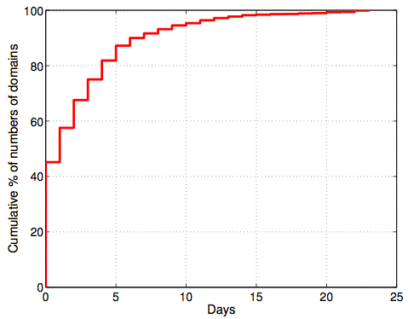
Prediction: Registration Occurs Before Attack!
More than 55% of the malicious domains appeared in spam campaigns more than one day after they were registered.

Slide 37
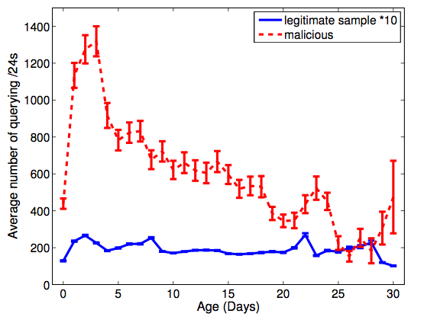
DNS Lookups Precede Attacks!
Queries to the scam domains increased quickly after the domains were registered, and usually reach the peak in the first 3–4 days.

Slide 38
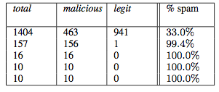
Early Lookup Behavior
Different malicious domains are looked up by similar group of network blocks, which may indicate that they are part of the same spamming campaign.

Slide 39
With Better Data, Possible to Predict Attacks Even Earlier!

Slide 40




DNS Predictive Analytics for Attack Prediction
Proactive Recognition and Elimination of
Domain Abuse at Time-of-Registration
Registration
Use
Detection
Life Cycle

Slide 41
Domain Profile Features
Data from registration event
Registrar, nameserver, character tri-grams, etc.
Includes edit distance to known bad domains
Insertion:
abcdef
abcHdef
Deletion:
abcHdef
abcdef
Substitution:
abCdef
abHdef

Slide 42
Registration History Features
Data from previous registration
Previous registrar, re-registration latency, etc.
Separate reuse into drop-catch and retread
Notes:
BUILD SUSPENSE: How quickly can this happen?

Slide 43
Batch Correlation Features
Data from registrations in same time interval
batch size, rate and types of reuse, etc.
Name cohesiveness using edit distance
Registration Batch
asklenderhome.com
askhomelendersnow.com
stationary.com
asklendershome.com
bestcooks.com
askhomelenders.com
Cohesive
Uncohesive
Notes:
Make clear that batch cohesion is a property of individual domains

